Slide 1

Fashion
BUSINESS
Magazine
Magazine

Slide 2
A
目 录
Fashion
CONTENTS
B
Fashion, is a kind of aesthetic view.
Business
C
good times, bad times.
Brief
Brief but not simple..

Slide 3
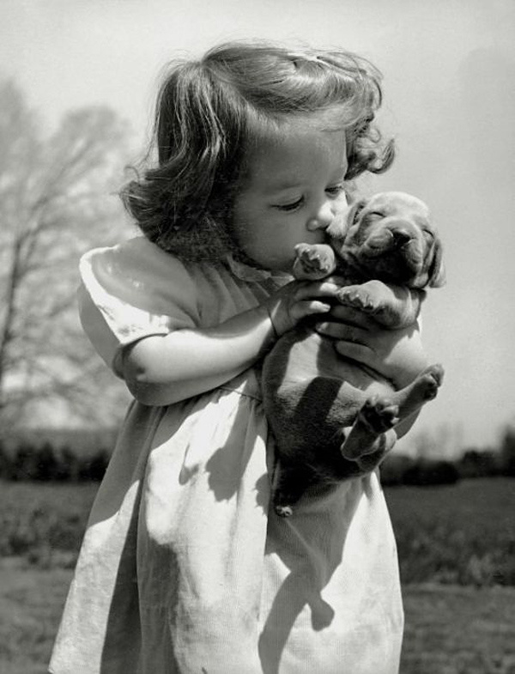
long time
fashion is a means of
resistance alone .
this is fashion realm.
aesthetic
view
Part One
long time
Fashion
aesthetic view

Slide 4

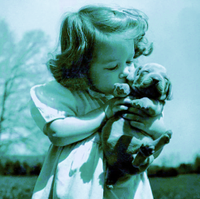

Fashion
I like this day, just like an outing
and I am happy ,
because I have seen such beautiful scenery
I like this day, just like an outing
and I am happy ,
because I have seen such beautiful scenery
A Kiss is kind of love.
It means that I like you very much.

Slide 5


Fashion
Fashion, is a kind of aesthetic view.
fashion
fashion
I like this day, just like an outing
and I am happy ,
because I have seen such beautiful scenery
aesthetic
aesthetic
aesthetic
aesthetic
fashion
fashion

Slide 6

Two
one
two
Fashion
I like this day, just like an outing
and I am happy ,
because I have seen such beautiful scenery
One
Three
one
two
Four
one
two

Slide 7
good time
all progress is based upon a universal innate desire on the part of every organism to live beyond its income.
good and
bad
Part Two
good times
Business
good times

Slide 8
good times, bad times.
Fashion is not only a kind of appearance, or an inner, popular
not be suitable for you, but according to the own characteristics to dress up yourself, you belong to that kind, mature, la dy, or simple and natural, or pure, or movement, a fact that can all be fas hionable. Hip-hop, cowboy wind, and the wind wind wind, occupation, fur, all-match, hippie, ladies fashion, Korean, Japanese, what is it Fashion is the special logo, is a city in the vast city of special psychological needs.
Such as Business

Slide 9

The tile: Business
It is not only a kind of appearance, or an inner, popular not be suitable for you, but according to their own characteristics to dress up yourself, you belong to that kind, mature, lady, or simple and natural, or pure, or movement, a fact that can all be fashionable. Hip-hop, cowboy wind, and the wind occupation, fur, all-match, hippie, ladies fashion, Korean, Japanese, what is it Fashion is the special logo, is a city in the vast city of special psychological needs.

Slide 10
80%
one
65%
two
45%
three
70%
four
The tile: Business
all progress is based upon a universal innate desire on the part of every organism to live beyond its income.
It is not only a kind of appearance, or an inner, popular not be suitable for you, but according to their own characteristics to dress up yourself, you belong to that kind, mature, lady, or simple and natural, or pure, or movement, a fact that can all be fashionable.

Slide 11
not simple
to see a world in a grain of sand. and a heaven in a wild flower
not
simple
Part Three
not simple
Brief
Brief but not simple

Slide 12


To see a world in a grain of sand. and a heaven in a wild flower.
one
To see a world in a grain of sand. and a heaven in a wild flower.
two
not
simple
Brief
not
simple
To see a world in a grain of sand. and a heaven in a wild flower.
three
To see a world in a grain of sand. and a heaven in a wild flower.
four

Slide 13
one
To see a world in a grain of sand. and a heaven in a wild flower.
two
To see a world in a grain of sand. and a heaven in a wild flower.
three
To see a world in a grain of sand. and a heaven in a wild flower.
Brief
Brief but not simple
three
To see a world in a grain of sand. and a heaven in a wild flower.
two
To see a world in a grain of sand. and a heaven in a wild flower.
one
To see a world in a grain of sand. and a heaven in a wild flower.

Slide 14



Brief
Brief but not simple.
one
To see a world in a grain of sand. and a heaven in a wild flower.
To see a world in a grain of sand. and a heaven in a wild flower.
one
two
To see a world in a grain of sand. and a heaven in a wild flower.
To see a world in a grain of sand. and a heaven in a wild flower.
two
To see a world in a grain of sand. and a heaven in a wild flower.
To see a world in a grain of sand. and a heaven in a wild flower.
three
three

Slide 15
Welcome
添加内容

Slide 16
